Slide 1
Notes:
“We are part of a broader community, and we have a responsibility to invest in society today, in order to make sure that there will be a business context where both we and society can thrive tomorrow.” James S. Turley, Chairman and CEO

Slide 2
Northern Champaign: An Underserved Community
Low income¹ (2000):
Immediately surrounding Douglass Park median household income is between $22,000 – 32,000
Housing¹ (2000):
Immediately surrounding Douglass Park 19 – 25% of monthly rent is less than $300
Education² (2004):
Percent low income students in all Champaign Unit 4 schools: 33.8%
Percent low income students at B. T. Washington Elementary: 68.2%
Percent low income students at Stratton Elementary: 81.8%
Stratton Elementary
Douglass Park
Center of U of Illinois Campus
2000 Census. www.census.gov
Regional Planning Commission. Champaign County Statistical Abstract

Slide 3
Our Vision: Create a Community Garden.
We envision our community garden to be an open space where residents can rent plots of land to grow their own food, learn about gardening, and strengthen their community.
Environment
Supports “green” agricultural practices
Provides high quality, affordable produce
Improves ecology and value of the surrounding community
Education
Instructs residents about the essentials of gardening and environmentalism through classes
Fulfills the “No Child Left Inside” Act
Promotes intergenerational cooperation
Emphasizes nutrition and physical activity
Entrepreneurship
Perpetuates a sustainable business by generating revenue
Draws further funding from other grants in the future
Environment
Education
Entrepreneurship
Vision
Support

Slide 4
Community Garden Success Stories
St. Louis and New York City
Community gardens increased home values, owner occupancy, and household income.
The greatest positive impact was found in the most economically disadvantaged neighborhoods.
Flint, Michigan
The city is using community gardens to offset problems with decreasing population and stagnation by turning to community empowerment.
Cincinnati
The City Barn Community Garden has been thriving for over three years.
It is integral in bridging two divergent socio-economic communities and provides a constructive outlet for the youth and unemployed.
The common success factor of each garden is the strong support of the local community & government
Environment
Education
Entrepreneurship
Vision
Support

Slide 5
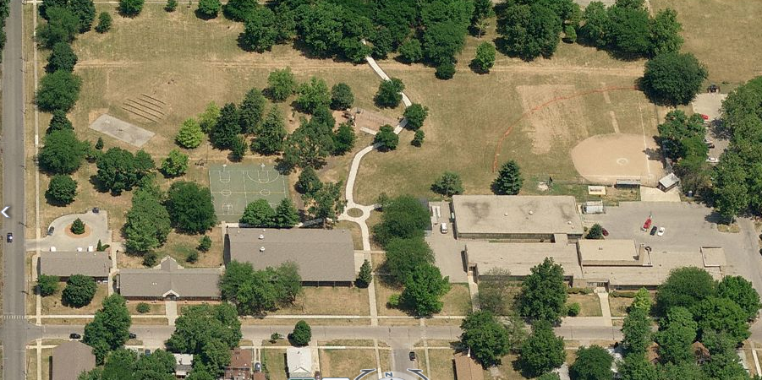
Located in Douglass Park (Northern Champaign)
The City of Champaign supports our initiative.
Land to be provided by the Champaign Park District.
Garden
B. T. Washington
Elementary School
Public Library
Community Center
Environment
Education
Entrepreneurship
Vision
Support

Slide 6
An Environmental Impact…
The carbon footprint will be reduced.
The average U.S. meal travels 1,500 miles. Providing a local source of produce will help reduce the distance food travels.
Water runoff will be absorbed.
The garden will provide area for water to infiltrate the soil and replenish groundwater supplies.
Landfill waste will be mitigated.
Using locally grown produce reduces the need for packaging, limiting the amount of waste material that ends up in landfills.
Air quality will be improved.
The plants grown in the garden will help filter the air while also absorbing carbon dioxide and adding oxygen.
Bio-diversity will be increased.
Replacing grass with multiple crops increases the number of species living in the area, providing resistance to disease and infestation.
Environment
Education
Entrepreneurship
Vision
Support

Slide 7
An Educational Experience…
Classes offered to the public (taking place in the community portion of the garden, the community center, and school on the property) will be supported by community leaders and university members.
Types of classes to be offered:
Composting, basic botany and planting, garden design, dealing with pests, basic nutrition, cooking and preservation, rain water sequestration
Intergenerational Programs
Working with existing Champaign youth-senior programs, we aim to integrate proven intergenerational education to promote sustainability, nutrition, and physical activity.
This will provide interaction for isolated seniors and role models for children.
Environment
Education
Entrepreneurship
Support
Vision

Slide 8
An Educational Experience (cont)…
B. T. Washington Elementary School
Partnership and close proximity to Booker T. Washington Elementary School will allow for integration of the classroom and garden.
No Child Left Inside Act (Federal Mandate):
The garden will bring this act to life by providing hands on environmental education, proven to improve science and social studies test scores.
Physical Activity
The garden will provide an opportunity for needed physical activity, especially in light of obesity concerns.
Nutrition
Low income households typically eat unhealthy foods. We will work with school children to provide nutrition education and fresh produce.
Environment
Education
Entrepreneurship
Support
Vision

Slide 9
An Entrepreneurial Venture…
The community garden is designed to become self-sufficient as it matures by generating revenue.
$25 per season for private plots, class fees, and selling a portion of the produce at two local farmers markets
The Social Entrepreneurship Institute at the College of Business will provide entrepreneurial skills workshops to elementary children at school and adults at the community center.
Marketing, basic finance, and business writing skills, among others, will be taught.
The skill sets learned will be applied while selling produce at the farmers markets.
Gardeners must abide by community garden guidelines regarding maintenance and gardening etiquette.
Environment
Education
Entrepreneurship
Support
Vision

Slide 10
Local & National Support
Champaign Park District
Will provide land at Douglass Park
City of Champaign
William Kyles, Champaign County Representative: liaison between all parties involved
Champaign Unit 4 School District
Kristine Chalifoux, School Board
University of Illinois, Education and Garden Coordinators
Collette Niland, Assistant Dean, College of Business
Zachary Grant, University of Illinois Student Farm manager
Master Gardeners led by Sandra Mason, University Horticulture Extension
Local businesses including:
Prairieview Landscaping: supply heavy machinery
True Value (hardware store): provide 10% discount on all purchases
B-Lime (a green store): publicize and promote the garden
Environment
Education
Entrepreneurship
Support
Vision

Slide 11
State Support

Slide 12
National Support

Slide 13
Douglass Park Garden: Timeline of Events
Jun. 2010 | Secure land Purchase supplies Meet community that will be impacted
Jul. 2010 | Take soil samples Develop curriculum with B. T. Washington
Aug. 2010 | Start school curriculum
Sept. 2010 | Start fall community classes
Oct. 2010 | Prepare land for winter, add nutrients
Nov. 2010 | Develop land layout
Dec. 2010 | Reservation of plots
Mar. 2011 | Prepare land for planting Start spring community classes Plan summer program with B.T. Washington and Park District
Apr. 2011 | Plant early plants, flowers, trees
May – Nov. 2011 | Food planting and harvesting

Slide 14
Total Anticipated Start Up Cost: $9,200
Items | Cost
Raised Beds (34) 40x4 ft. | $5,500
Soil (100 cubic yards) | $1,200
Mulch | $500
Compost (50 cubic yards) | $1,000
Storage Shed | $500
Spades, gardening forks, rake, hoes, shears, loppers, saws hoses and other tools | $500
Labor for shed, raised bed construction and land preparation | Volunteer
Water access | Donated by City
Land | Donated by Park District
The remainder of the $10,000 will be used to subsidize classes
Source: UrbanHarvest.org

Slide 15
Name | Department | Year | Email | Phone
Cameron Blaydes | Finance and Accounting | Freshman | blaydes1@illinois.edu | (847) 502-0657
Erin Harper | Natural Resources in Environmental Science | Junior | harper7@illinois.edu | (217) 649-5084
Steven Heiss | Accounting and Marketing | Freshman | heiss2@illinois.edu | (847) 421-5120
Sibel Leblebici | Materials Science and Engineering | Senior | slebleb2@illinois.edu | (217) 778-9548
Victoria Ngo-Lam | Finance and Accounting | Freshman | ngolam1@illinois.edu | (314) 799-5728
Diana Rechenmacher | Accounting | Freshman | rechenm@illinois.edu | (630) 484-8225
Jonathan Weisman | Chemical Engineering | Freshman | weisman4@illinois.edu | (513)673-2961

