Slide 1
Citizens , Experts & Local Environmental Knowledge Ken Salo DURP at UIUC kensalo@illinois.edu

Slide 2
Personal Introduction
B. Science and Masters in Public Law (LLM);
At Cape Peninsula University of Technology (CPUT) I founded a cross campus Environmental Unit to promote PAR protocols with urban poor people
I currently, teach a workshop and courses on Int Urban Environmental Conflicts, Social Inequalities and Right to the City.

Slide 3
Outline
Introduction of key debates on the role of expert and local env knowledge (LEK) for public health and planning practices
Case study:
Context: N. Champaign
Community client: CUCPJ
Conflict: environmental health risk assessment of an abandoned
University-community collaboration through UP 478 Workshop
Reflect on lessons of case study for key debate

Slide 4
Key Debates
How can local, experiential forms of knowledge and expert, scientific knowledge (of env health) interact in ways that neither exclude nor exploit/romanticize local knowledges (beyond the binary of experiential v expert knowledge)?
How do dissenting social movements make visible the structural inequalities in urban landscapes and promote democratic models of decision making?

Slide 5
LEK Debates in Public Health
Recognize that scientific risk assessment’s (SRA), are contextual and contingent on the willingness of citizens to accept expert scientific framings.
Emerging hybrid models call for : analytic-deliberative processes of decision making.

Slide 6
LEK Debates in Urban Planning
Collaborative/Insurgent planning orientations argue that (techno-scientific) planning practices produce “ instrumental” effects and unstable spaces.
Stable spaces are the temporary outcome of struggles between formal actors and informal social movements over equitable ways to share space.

Slide 7
Urban Health Movements in US
Urban Sanitary Movements ( Jane Addams’s 1895 Hull House Maps )
Neighborhood Health Center ( pre WW1)
1960’s Civil Rights Movements (Highlander Folk Center, TN ; Young Lords in E Harlem ;
Anti-toxics, Env Justice and Right to the City Movements ( Lois Gibbs’s Citizens Clearing House in Love Canal, NY)

Slide 8
LEK Debates in UP 478 workshop
UP 478 engages a community client (CU Citizens for Peace and Justice) in debates on how poor people participate in reshaping urban inequalities in CU.
Advocates that planning is normative field and planners should mediate between scientific experts, policy analysts and local communities in ways that promote democratic, cross-cultural dialogues.

Slide 9
Case study and Context:
Context: N. Champaign
Community client: CUCPJ
Conflict: environmental health risk assessment of an abandoned site
Outcomes of the university-community collaboration through UP 478 Workshop

Slide 10
Contested re-presentations of case study context
N End as segregated space due to suburbanization ,white flight and urban renewal projects;
Douglass Park Neighborhood as socio-cultural center
City District 1 connected to campus via 4th Street and downtown via N First Street development corridor;
Planning Area 2 in need of preservation.

Slide 11
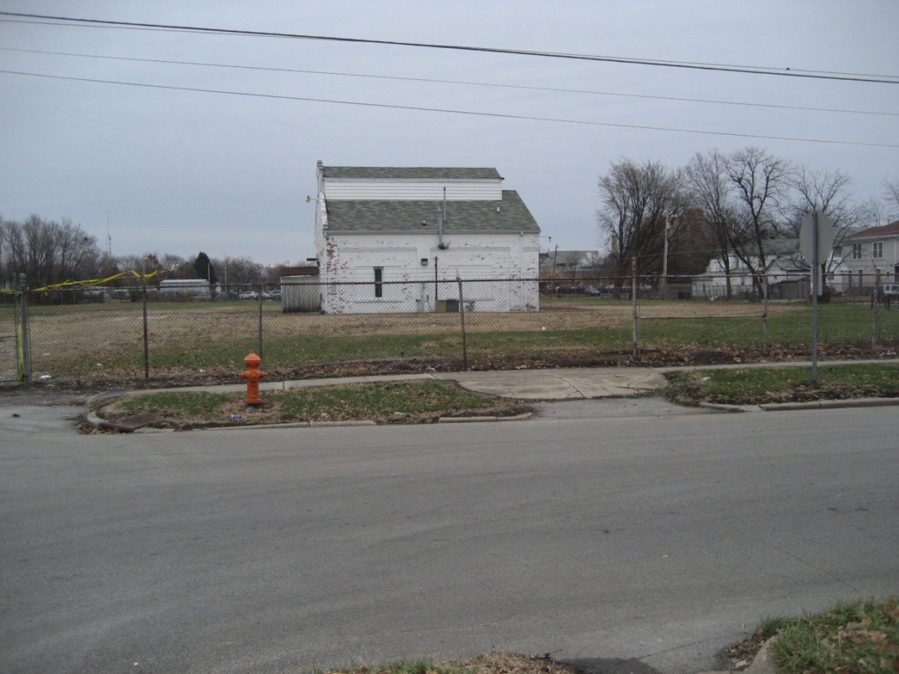
Case Study
CUCPJ’s FOIA request to the IEPA in response citizen concerns about health risk of vacant lot.
UP 478, 2007 adopts CUCPJ as community client.

Slide 12
Former Manufactured Gas Plant in North Champaign, image circa 1953
UP 478 activities
a) Archival search:

Slide 13
Sanborn map of the FMGP Site, circa 1892

Slide 14
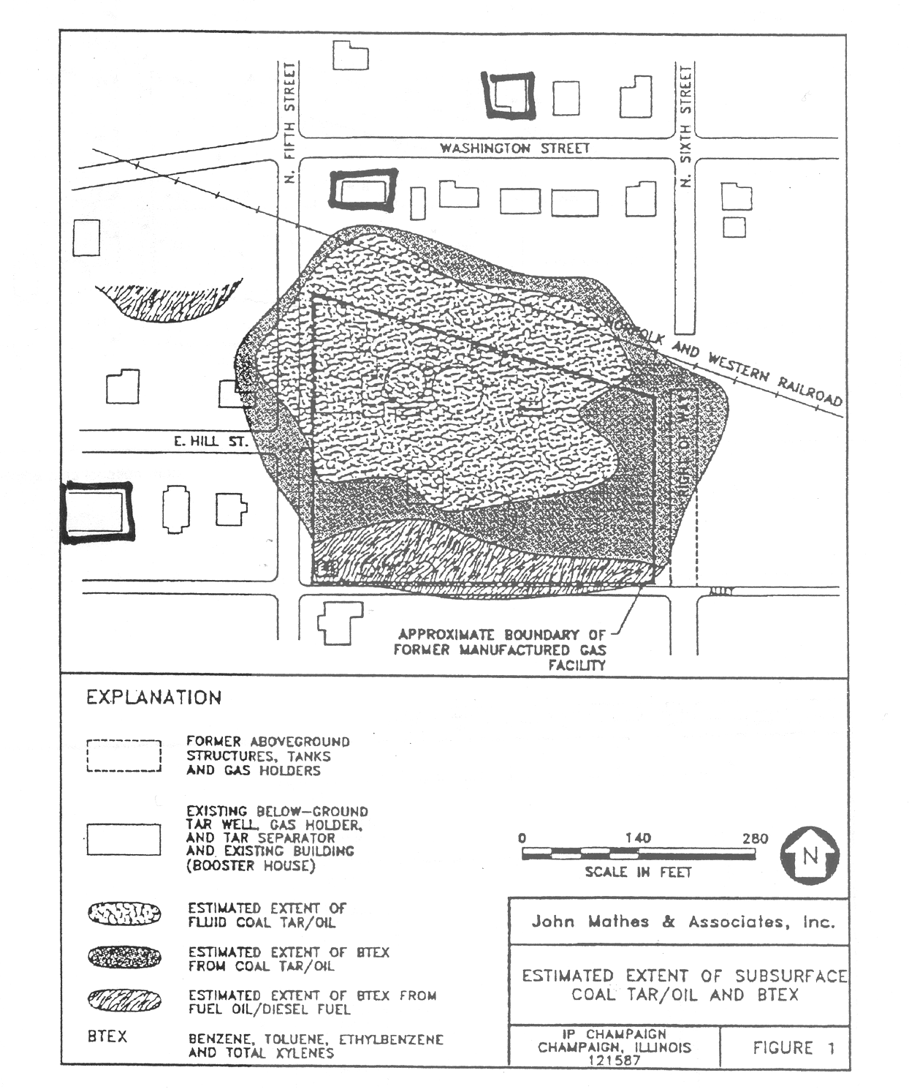
Ameren-IP map of underground toxins, 1990
UP 478 activities
b) Freedom of Information Act (FOIA) request

Slide 15
Other UP 478 workshop activities
c) Attending closed meetings and open houses;
d) Organizing public meetings;
e) Toxic tours;
f) Radio programs, focus groups and face to face interviews;
g) Organizing health-justice coalitions;
Mapping local knowledge of health concerns
Revealing contrasting evidence for counter claims.

Slide 16
Ameren’s positions and practices
Ameren IP claims that their voluntary site remediation project (VSRP) is compliant with federal and state laws and in progress since 1990’s.
Their community relations protocol has put information in public domain.
Local area librarian claims that no information was ever deposited at Douglass Public Library;
CUCPJ claims that fencing and signage is inadequate and breaks in the perimeter fence not fixed.

Slide 17
Other actors’ positions and practices
Coalition of IEPA/CCPHD/CC/ICC claims that
Ameren IP’s VSRP is legally compliant,
Their SRA is adequate and confirms that underground toxins present no immediate threat to public health;
VSRP adequate for non-residential development of urban Brownfield.

Slide 18
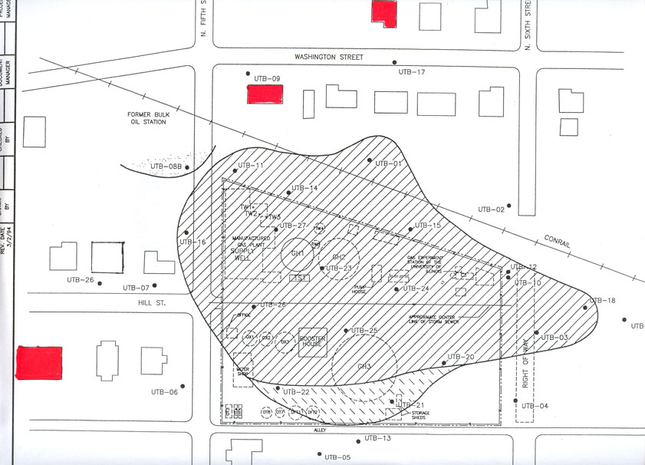
UP 478 mapping LEK of cancer cases

Slide 19
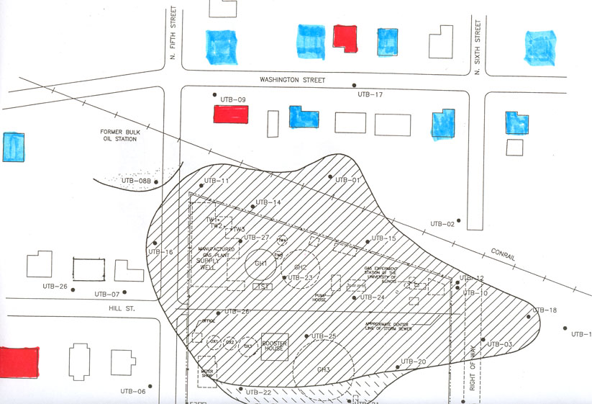
UP 478 mapping LEK of chronic health problems

Slide 20
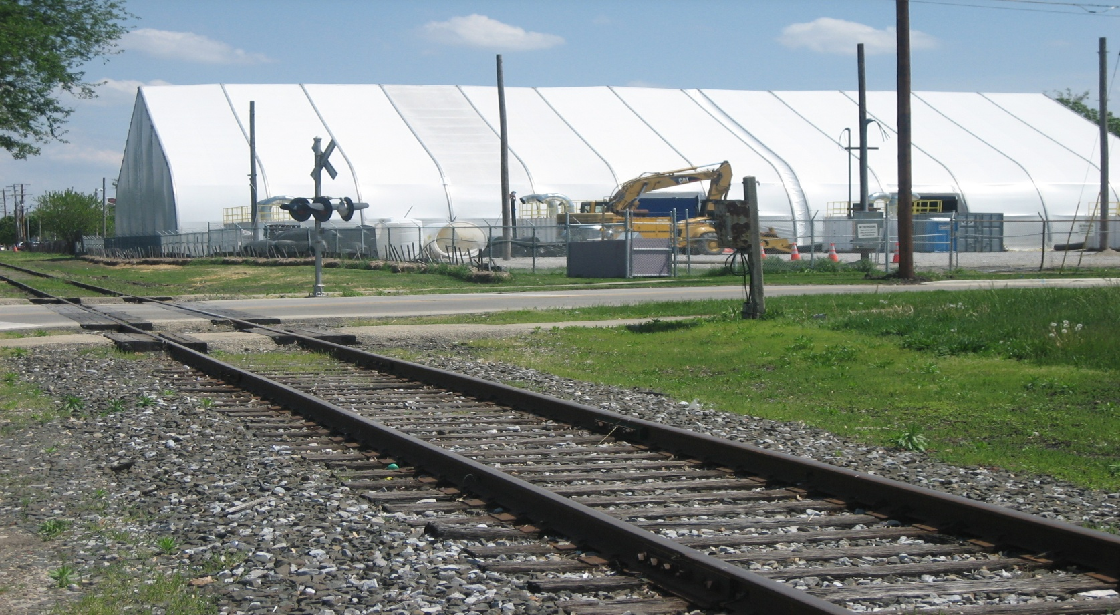
Making FMGP visible

Slide 21
Reflection
Challenges of working in segregated and fragmented communities:
-difficult history of university engagement with the N. End community (eg Ken Reardon’s project). Creation of CC neighborhood services and Neighborhood Wellness Plan;
-politics of economic revitalization versus public health in city council;
-failed NGO-CBO coalition (funding)
Revealing adverse environmental health risks in the face of power.

Slide 22
Conclusion
Participatory mapping of LEK can reveal structural inequalities
LEK can offer opportunities for integrating local and scientific forms of knowledge when power disparities are not extreme;
Dissenting practices of counter-hegemonic movements create moments for participatory planning practices.

